Slide 1

Minor Project
PLACEMENT PREDICTION
Sakshi Neeraj
A2305220101
4CSE2

Slide 2
TABLE OF CONTENTS
01
PROBLEM STATEMENT AND DATASET
02
PROJECT CYCLE
Data importing
Data organization
Exploratory Data Analysis
Data Visualization
Data Deployment

Slide 3
Problem statement
This is a study of publicly accessible data regarding on-campus placement of applicants depending on characteristics such as high school graduation percentage and domain of specialisation.
Using machine learning algorithms on this dataset, placement status of a candidate is predicted.

Slide 4
The dataset
This data set consists of Placement data of students in a XYZ campus. It includes secondary and higher secondary school percentage and specialization. It also includes degree specialization, type and Work experience and salary offers to the placed students.
https://www.kaggle.com/datasets/benroshan/factors-affecting-campus-placement

Slide 5

PROJECT CYCLE
DATA IMPORTING
DATA ORGANIZATION
EXPLORATORY DATA ANALYSIS
DATA VISUALIZATION
DATA DEPLOYMENT
USING MACHINE LEARNING ALGORITHMS AND THE IMPORTED DATA FOR PREDICTION
TURNING THE DATASET INTO AN EASILY READABLE TABULAR FORM
PERFORMING EXPLORATORY DATA ANALYSIS LIKE OUTLIER DETECTION, ENCODING AND FEATURE SCALING
DATA IS IMPORTED FROM EXTERNAL SOURCES
ENTAILS THE REPRESENTATION OF DATA IN GRAPHICAL FORM

Slide 6
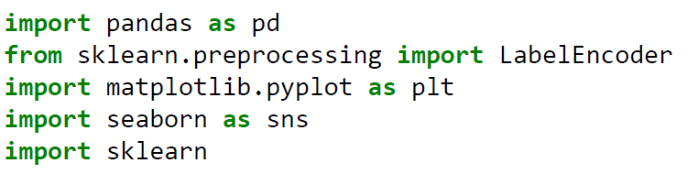
Importing the libraries
Importing the dataset

Slide 7

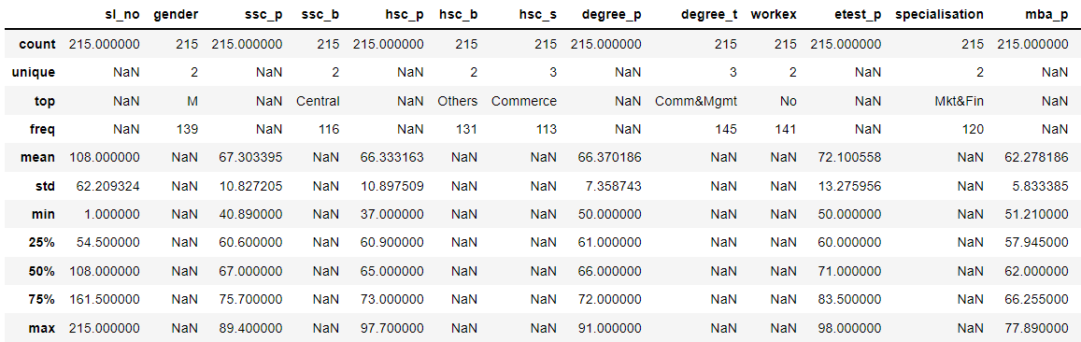
Exploring the features

Slide 8
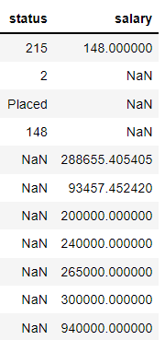
Exploring the features
KEY:
ssc_p - Senior school percentage
ssc_b - Senior school board
hsc_p - High school percentage
hsc_b - High school board
hsc_s - High school stream
degree_p - Percentage obtained in undergraduation
degree_t - Stream in which degree is pursued
mba_p - Percentage obtained in MBA

Slide 9

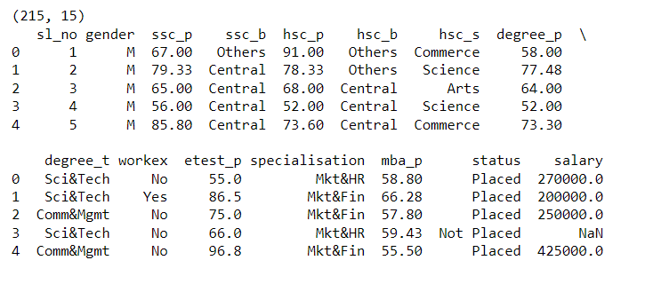
Exploring the features

Slide 10
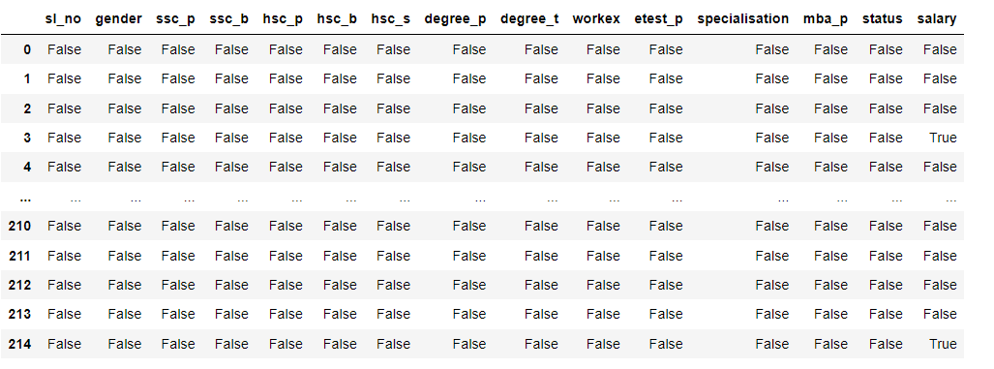
Null value detection

Slide 11
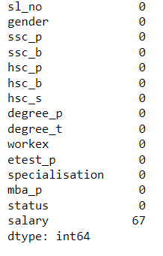
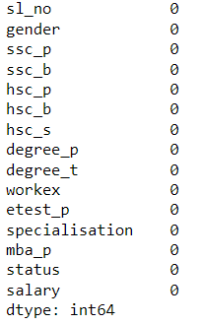
Null value detection
Replacing null salaries

Slide 12
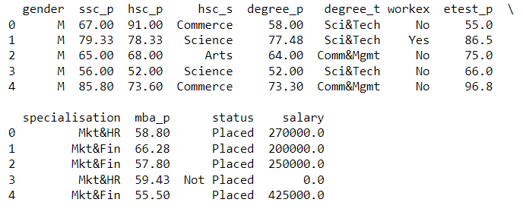
Dropping the not needed features

Slide 13
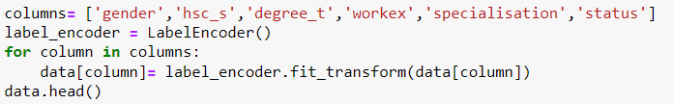
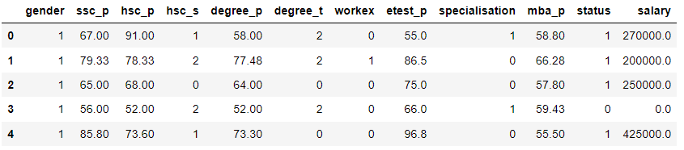
Encoding

Slide 14
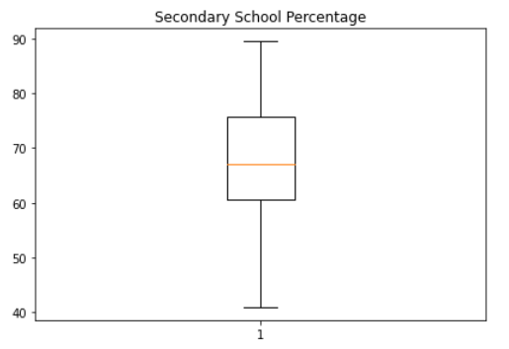

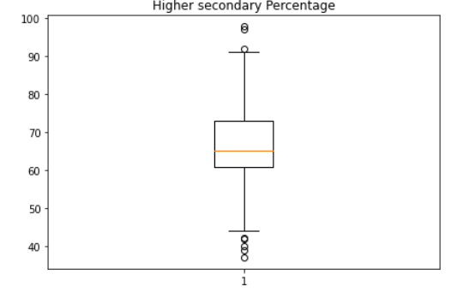

Outlier detection

Slide 15
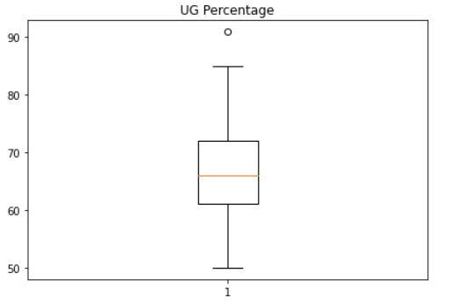

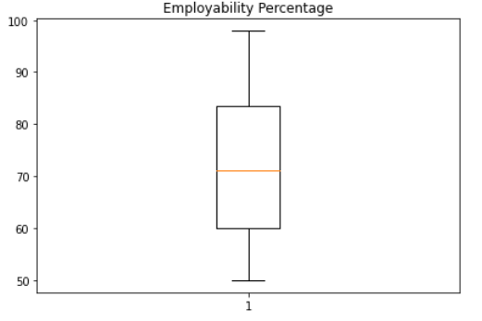

Outlier detection

Slide 16
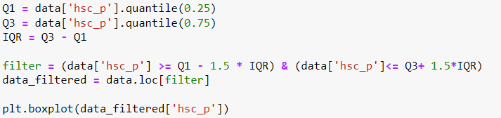
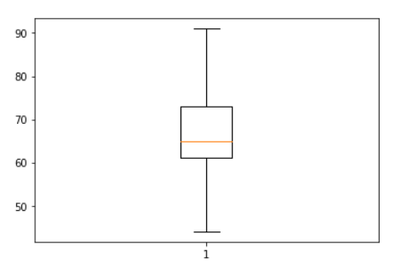
Outlier removal

Slide 17



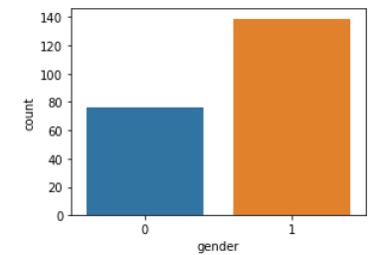
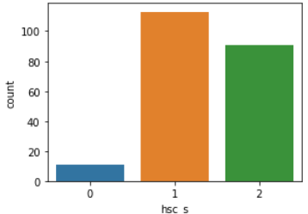
Visualisation using count plot

Slide 18

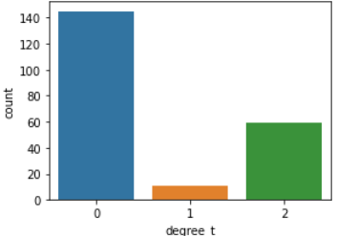
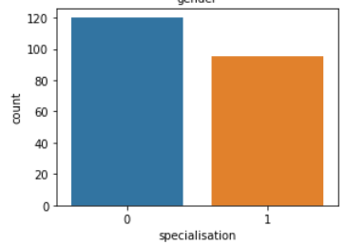
Visualisation using count plot

Slide 19
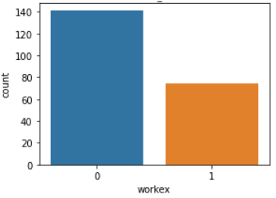
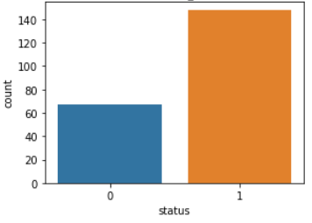
Visualisation using count plot

Slide 20
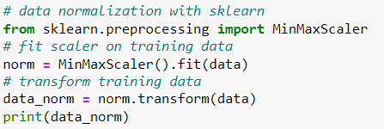
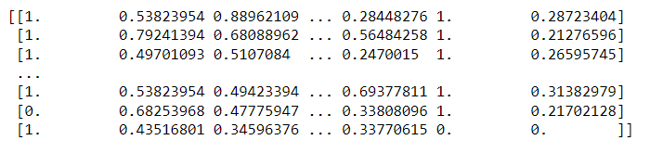
Normalization

Slide 21

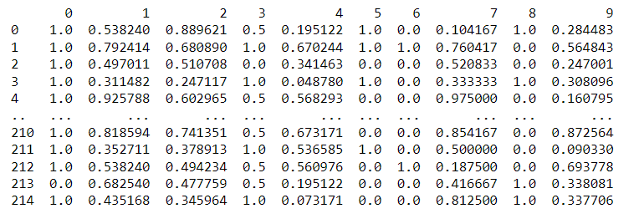
Normalization

Slide 22
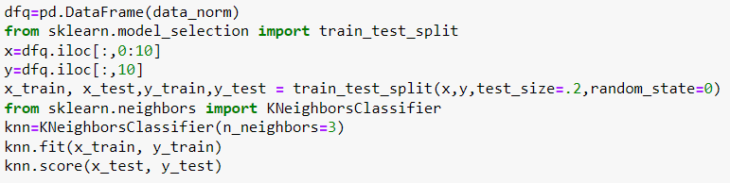
Prediction using KNN

Slide 23



Prediction using KNN

